Slide 1
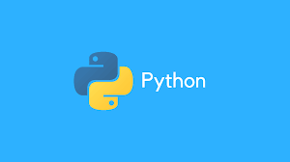
Python Programming Course Handbook 2024-2025
Welcome to the “Ultimate Python Programming Handbook," your comprehensive guide to mastering Python programming. This handbook is designed for beginners and anyone looking to strengthen their foundational knowledge of Python, a versatile and user-friendly programming language.

Slide 2
Agenda
PURPOSE AND AUDIENCE
STRUCTURE AND CONTENT
WHY PYTHON?
ACKNOWLEDGEMENTS
CONTENTS OF COURSE
CONCLUSION

Slide 3
PURPOSE AND AUDIENCE
This handbook aims to make programming accessible and enjoyable for everyone. Whether you're a student new to coding, a professional seeking to enhance your skills, or an enthusiast exploring Python, this handbook will definitely be helpful. Python's simplicity and readability make it an ideal starting point for anyone interested in programming.

Slide 4
STRUCTURE AND CONTENT
The handbook is divided into clear, concise chapters, each focused on a specific aspect of Python:
Fundamental Concepts: Start with the basics, such as installing Python and writing your first program.
Practical Examples: Illustrative examples and sample code demonstrate the application of concepts.
Hands-On Exercises: End-of-chapter exercises reinforce learning and build confidence.
Additional Resources: References to official Python documentation for deeper exploration.

Slide 5
WHY PYTHON
Python is known for its simplicity and readability, making it perfect for beginners. It is a high-level, interpreted language with a broad range of libraries and frameworks, supporting applications in web development, data analysis, AI, and more. Python's versatility and ease of use make it a valuable tool for both novice and experienced programmers.

Slide 6
ACKNOWLEDGEMENTS
I extend my gratitude to the educators, programmers, and contributors who have shared their knowledge and insights, shaping the content of this handbook. Special thanks to all the students watching my content on YouTube and Python community for maintaining a supportive and inspiring environment for learners worldwide.

Slide 7
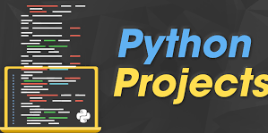
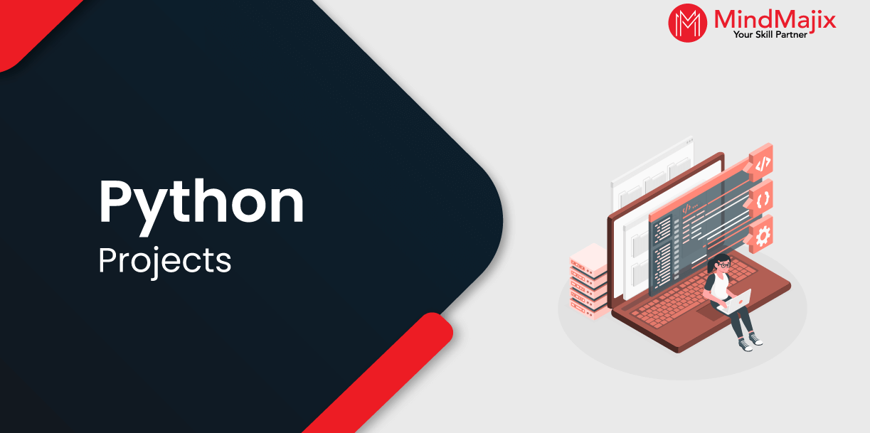
CONTENTS OF COURSE
BASIC TO ADVANCE
PROJECT
MAJOR PROJECT
UNIT 1 TO 8 IS BASIC CHAPTER
UNIT 9 TO 11 IS INTERMEDIATE CHAPTER
UNIT 12 AND 13 IS ADVANCE CHAPTER
Small Project 1 After Ch 1 to 8
Small Project 2 After Ch 9 to 11
Major Project 1
Major Project 2
After Ch 12 And 13

Slide 8
STRATING DATE
DATE FOR STRATING PYTHON : 01/12/2024
COURSE FEES : 250
COURSE LANUAGE : HINDI
DURATION : 2 MONTHS
TIME TOTAL : 140 HOURS
DALIY : 2 HOURS
WITH CERTIFICATE
TIME : 5:00 PM TO 7:00 PM

Slide 9
CONCLUSION
Learning programming can be both exciting and challenging. The “Ultimate Python Programming Handbook" aims to make your journey smooth and rewarding. Watch my video along with following this handbook for optimal learning. Let this guide be your stepping stone to success in the world of programming.

